Slide 1
How to Swiki
Appendix A
Using the CoWeb for
Collaboration and Sharing Media
Barb Ericson
Georgia Tech
June 2005

Slide 2
Learning Goals
Be able to create and edit pages on the CoWeb (Collaborative Website) http://coweb.cc.gatech.edu/ice-gt/
  Using CoWeb notation for tables and lists
  Using HTML as desired
  Linking to external resources
Be able to upload media and share it

Slide 3
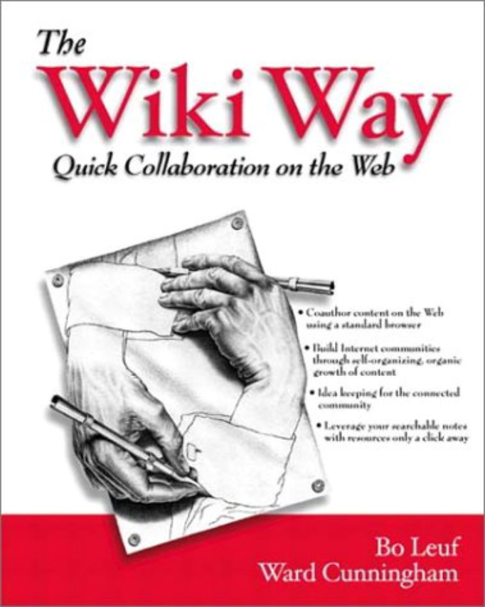
CoWeb: A Website where Pages are Editable
A CoWeb is a kind of “Wiki” (invented by Ward Cunningham)
  Every page is editable by anyone
    Caveat “locks”
  Anyone can create new pages
    By creating links
The CoWeb is also called “Swiki” for “Squeak Wiki”
  Squeak is the programming language used in building the CoWeb

Slide 4
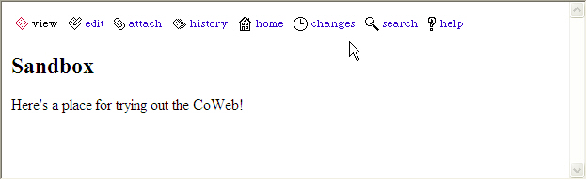
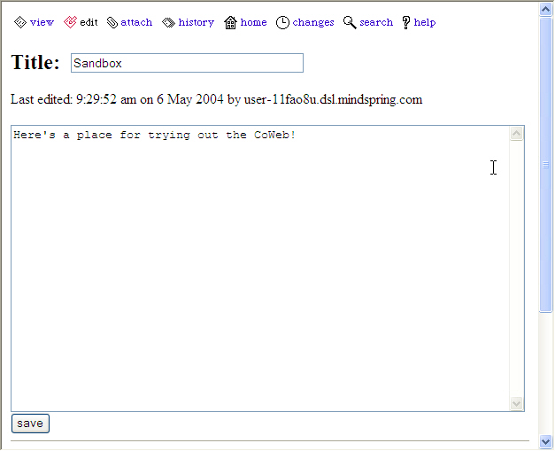

CoWeb pages: Web plus Edit

Slide 5
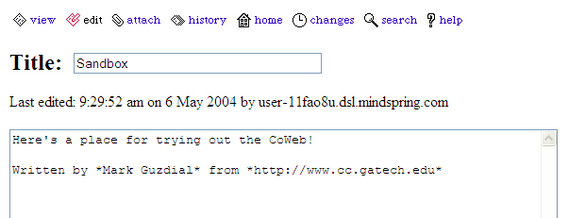
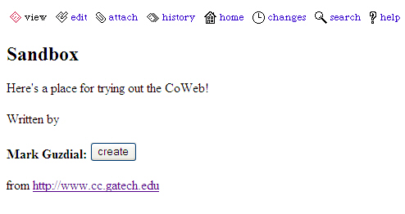
Asterisks create links
Since the page “Mark Guzdial” didn’t exist yet, we get to create it.
*http://www.cc.gatech.edu* becomes a live link to that page.

Slide 6
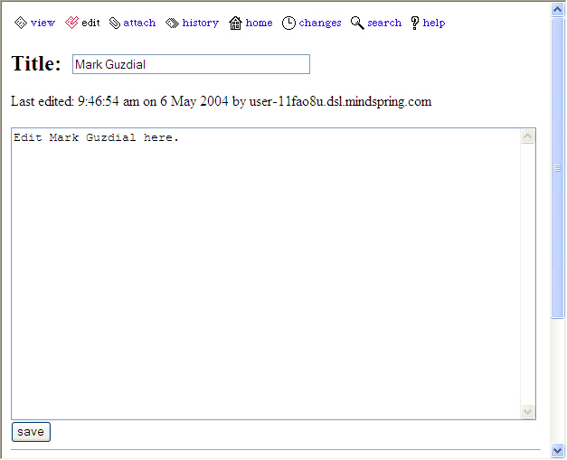

Create pages by clicking and editing

Slide 7
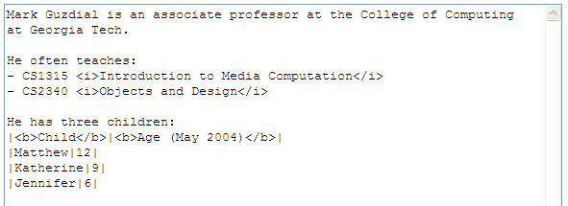
Creating tables and bulleted lists
We can mix HTML (like <i> for italics </i>) in CoWeb pages.
Dashes create bullets
Vertical bars separate columns for tables

Slide 8
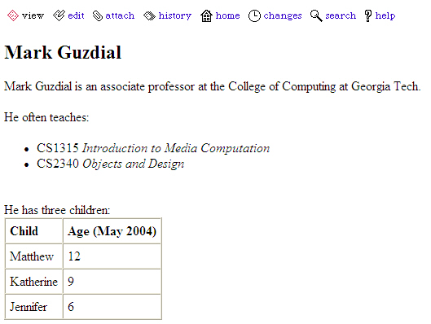
How that looks saved
Help is available on every page
Italics
Boldface
Table

Slide 9
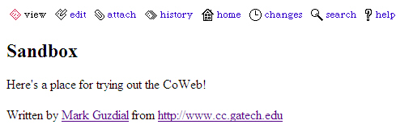
Can Reference the Page Anywhere
Now, anywhere in this CoWeb where I have *Mark Guzdial*, I will be linking to that page.
How the Sandbox looks now:

Slide 10
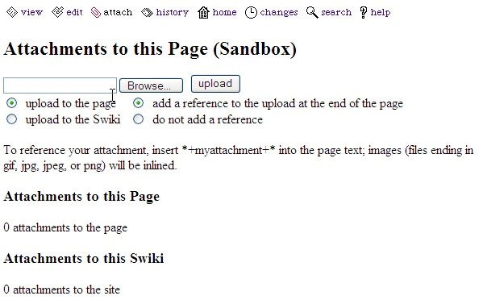
Sharing Media in the CoWeb
You can attach files (images, sounds, Word files, Powerpoint files)
  Copies from your computer to the CoWeb server

Slide 11
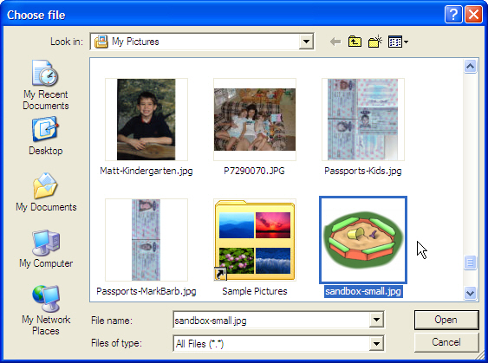

Uploading a picture
Click “Browse” to find the file that you want to upload.
Click “upload” to send it to the server.

Slide 12
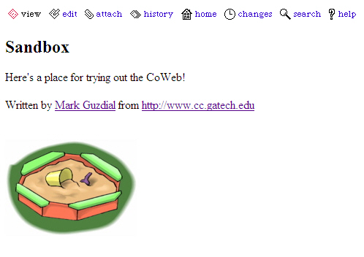
Adding a sandbox to the Sandbox
Images that are uploaded are automatically shown on the page.

Slide 13
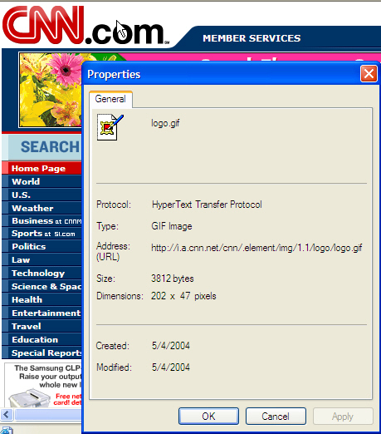
You can reference images elsewhere
You simply need the URL of the image
  Right click on image, and view its properties.
  The URL for the image will be displayed

Slide 14
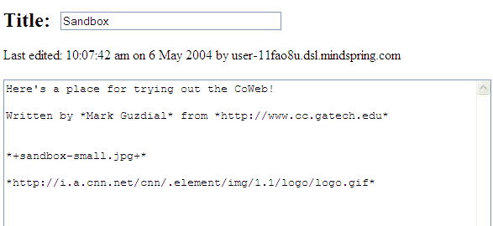
Inserting the image into the page
Uploaded files are inserted as *+filename+*
  Warning: You can’t use spaces or underscores (_) in uploaded files.
We can reference other images by using asterisks.

Slide 15
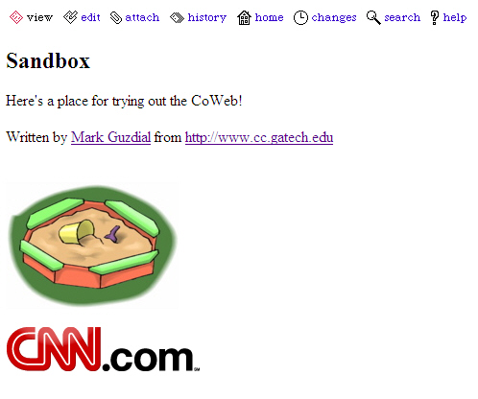
Both images now appear

Slide 16
Summary
A CoWeb is an editable website that simplifies collaboration and sharing of media.
  Anyone can edit any page.
  Anyone can create new pages.
You can easily create bulleted lists or tables
  You can use HTML if you know it.
You can upload media for sharing.
  Or reference media or other web pages.

